Slide 1
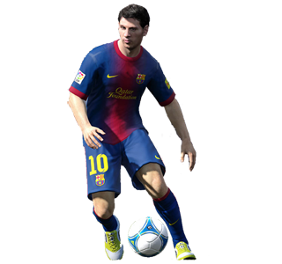
WSP 370: FIFA-19 ANALYSIS
AND
PREDICTION OF PLAYER PERFORMANCE POTENTIAL
By
Chinmayi Appajigowda
Dittu parashar
Hurairah(Roy)
Bhawna Seth
Olga Sfard

Slide 2

ABOUT THE DATA
FIFA 19 is a football simulation video game developed by EA Vancouver as part of Electronic Arts’ FIFA series *
Source: https://www.kaggle.com/karangadiya/fifa19
Total rows = 18,207
Total columns = 89
*
https://en.wikipedia.org/wiki/FIFA_19

Slide 3
IMPORT THE DATA SET INTO R
fifa = read.csv("fifa.csv", header = TRUE,skip=0, na.strings=c(""," ","NA"))
Select columns of interest:
  Age
  Club
  Potential
  Nationality
  Wage_in_K
  Value_in_Million
  Overall
  ShortPassing
  Dribbling
  BallControl
  Reactions
  Balance

Slide 4
CLEAN THE DATA AND REMOVE MISSING VALUES
Clean Data
  Value (column) : € 105M = Value_in_Million :100
  Wage (column) : € 200K = Wage_in_K: 200
Remove the missing values
  fifa=fifa[complete.cases(fifa),]
  Final Dataset has 17918 Rows (removed 289 rows)

Slide 5
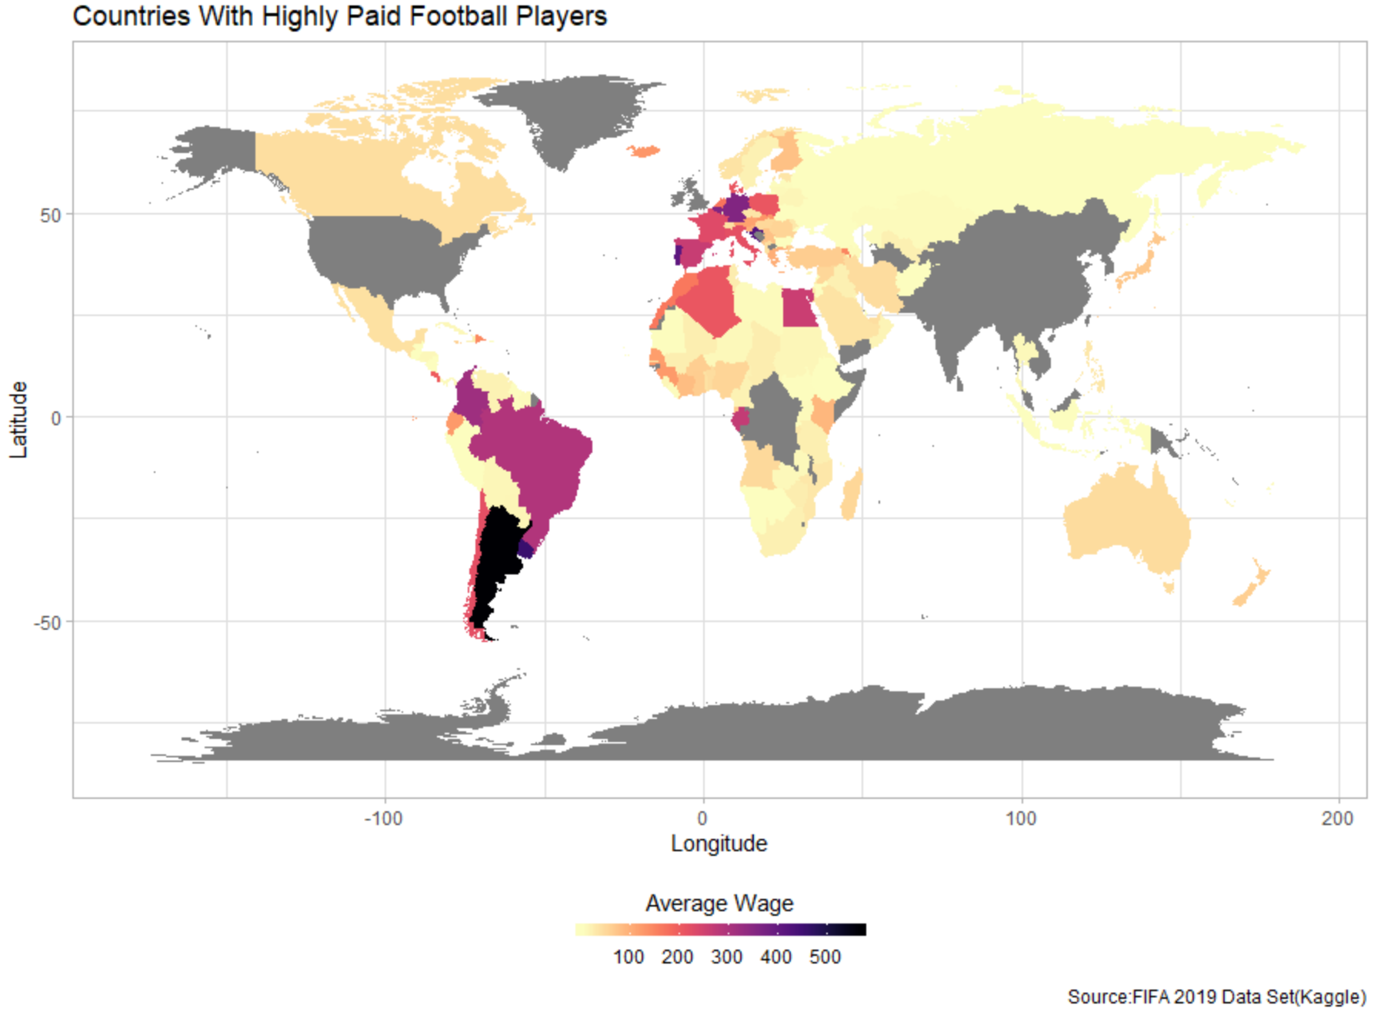

GEOGRAPHICAL DISTRIBUTION OF AVERAGE PLAYER WAGE

Slide 6
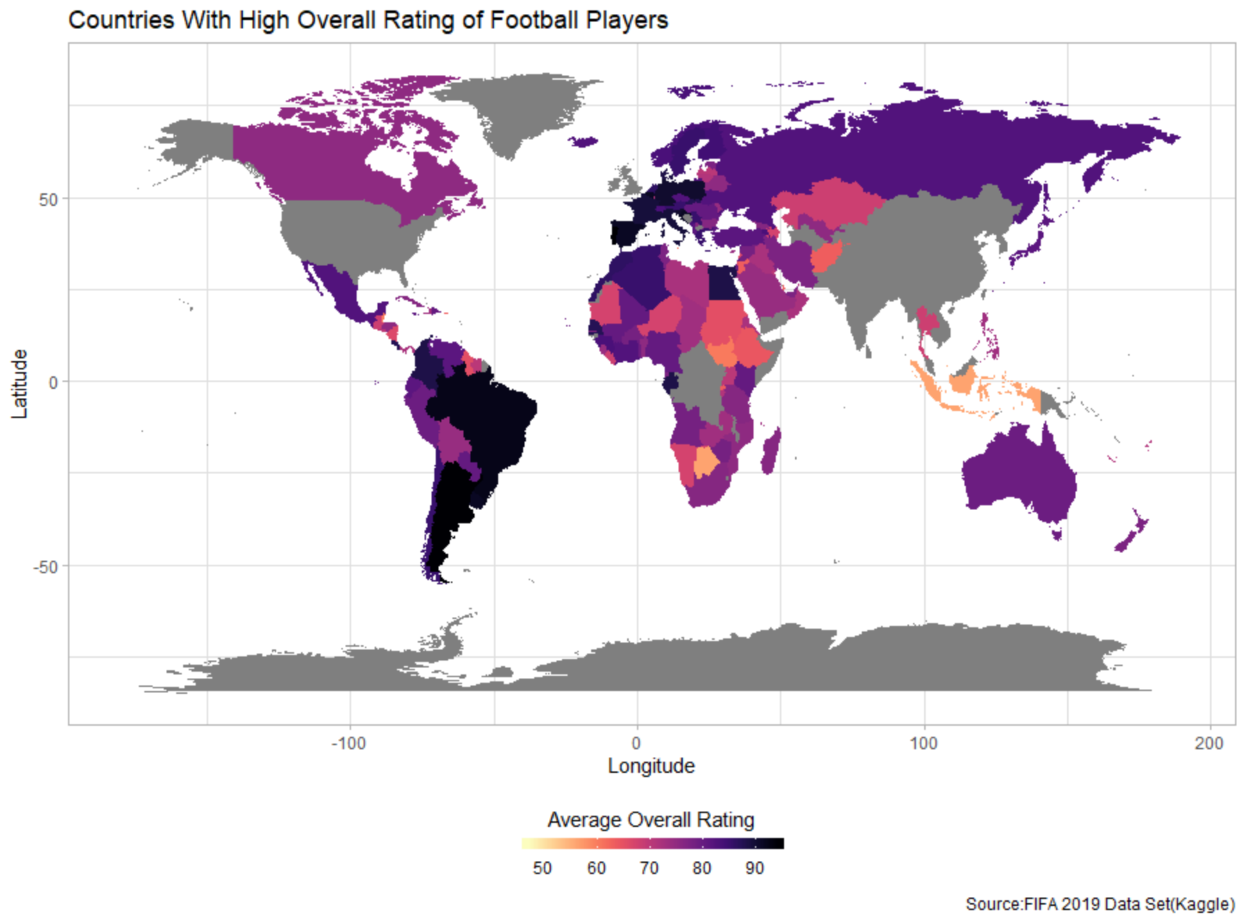
GEOGRAPHICAL DISTRIBUTION OF AVERAGE PLAYER OVERALL RATING

Slide 7
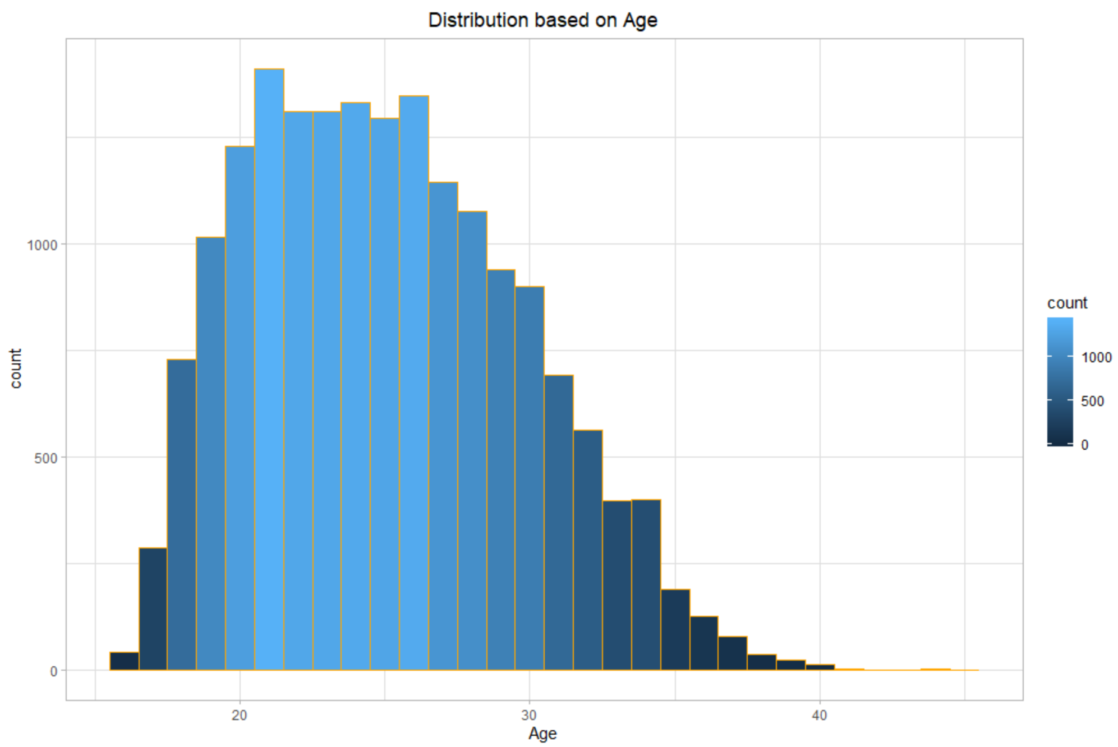
DISTRIBUTION OF PLAYER AGE

Slide 8
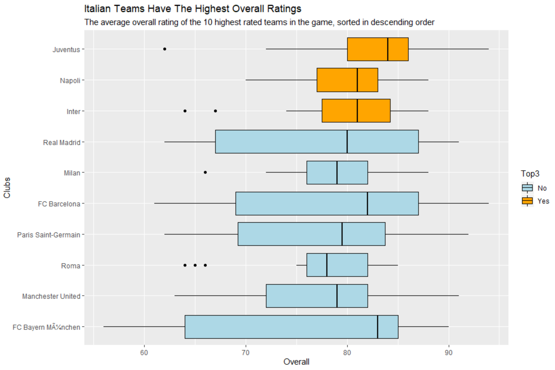
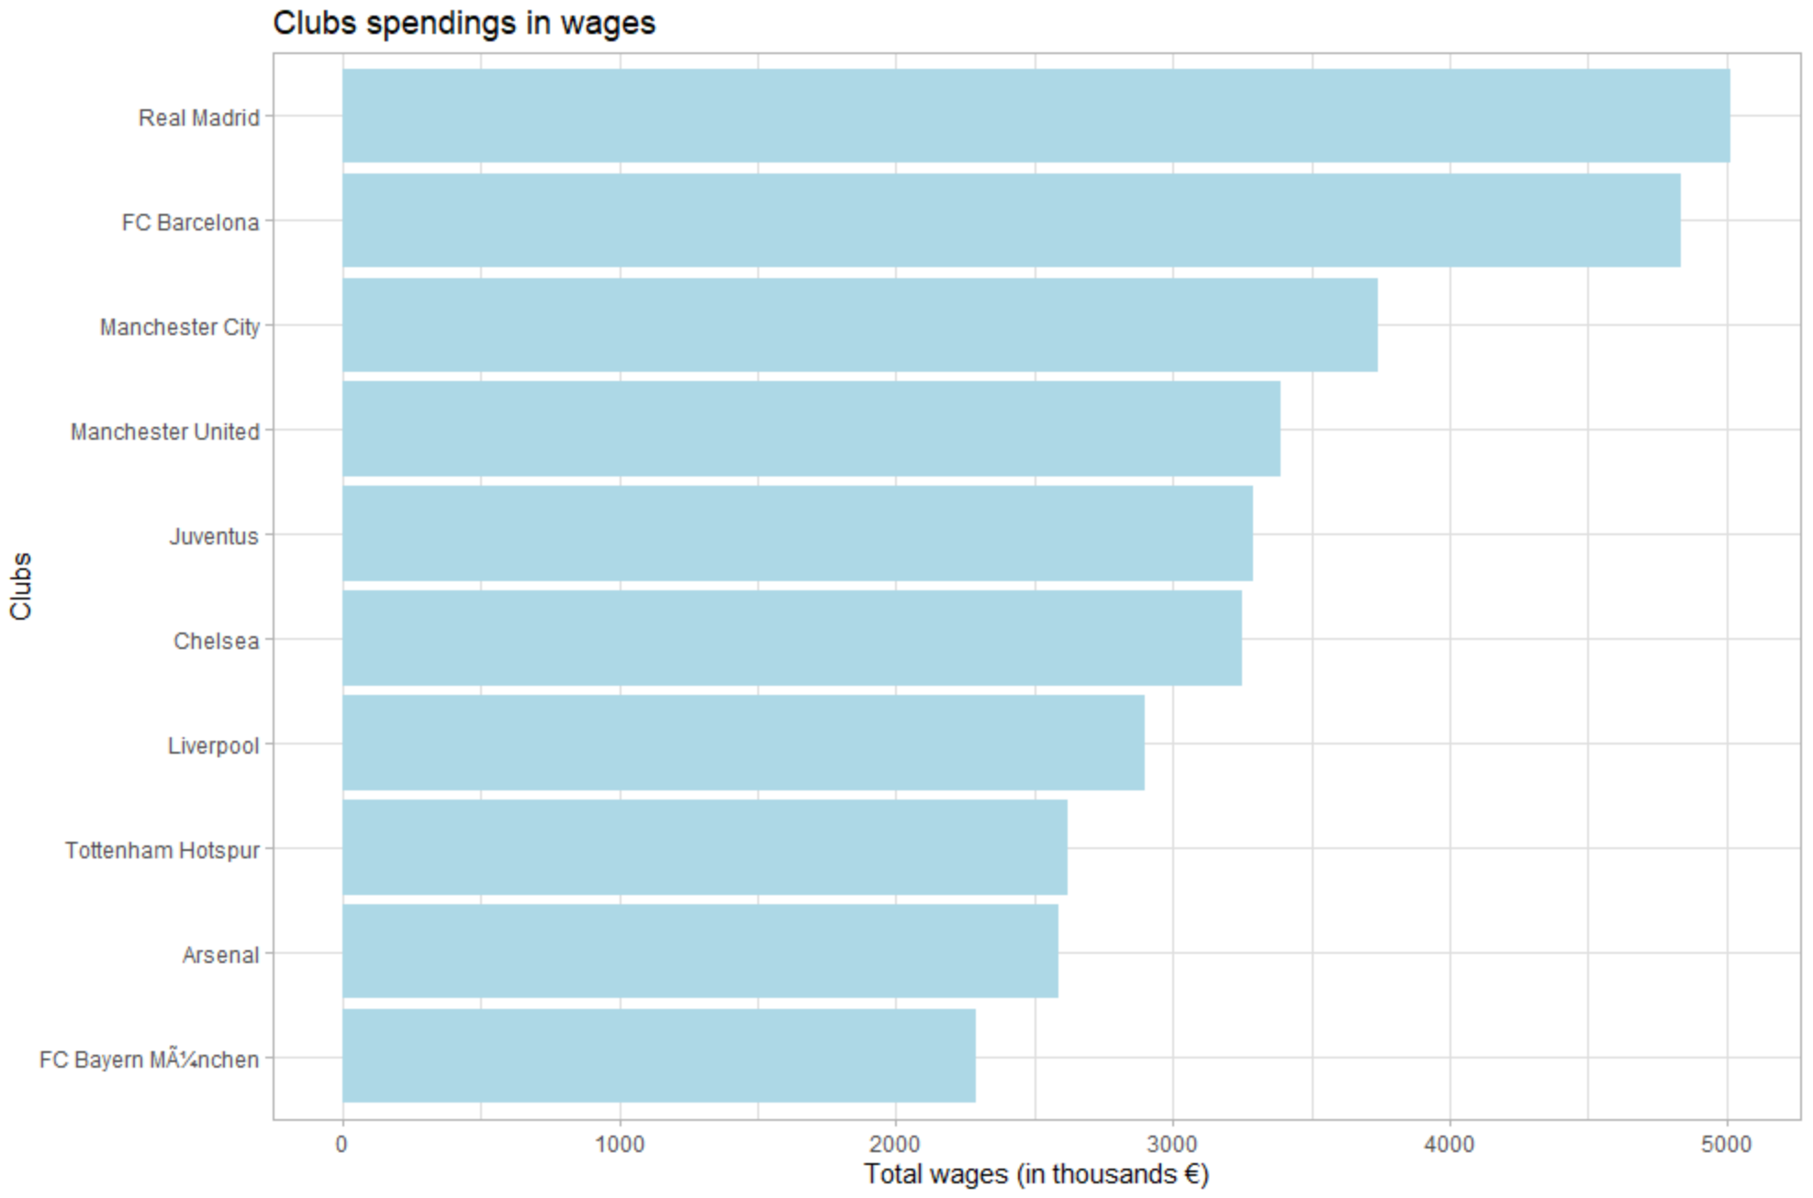
TOP CLUB STATISTICS
Teams With The Highest Overall Ratings
The average overall rating of the 10 highest rated teams in the game, sorted in the descending order

Slide 9
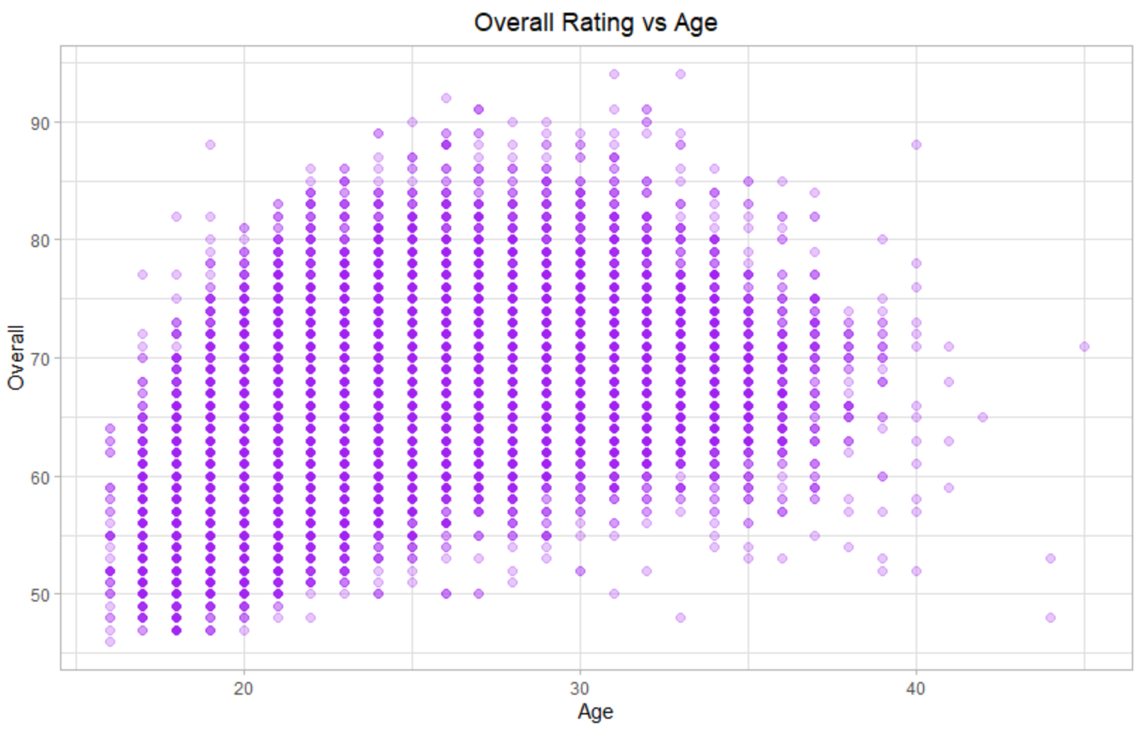
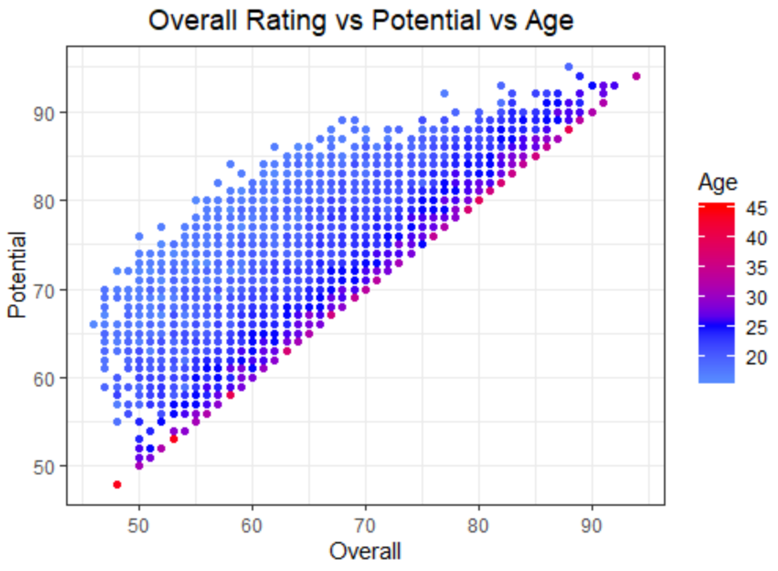
OVERALL RATING VS AGE VS POTENTIAL

Slide 10
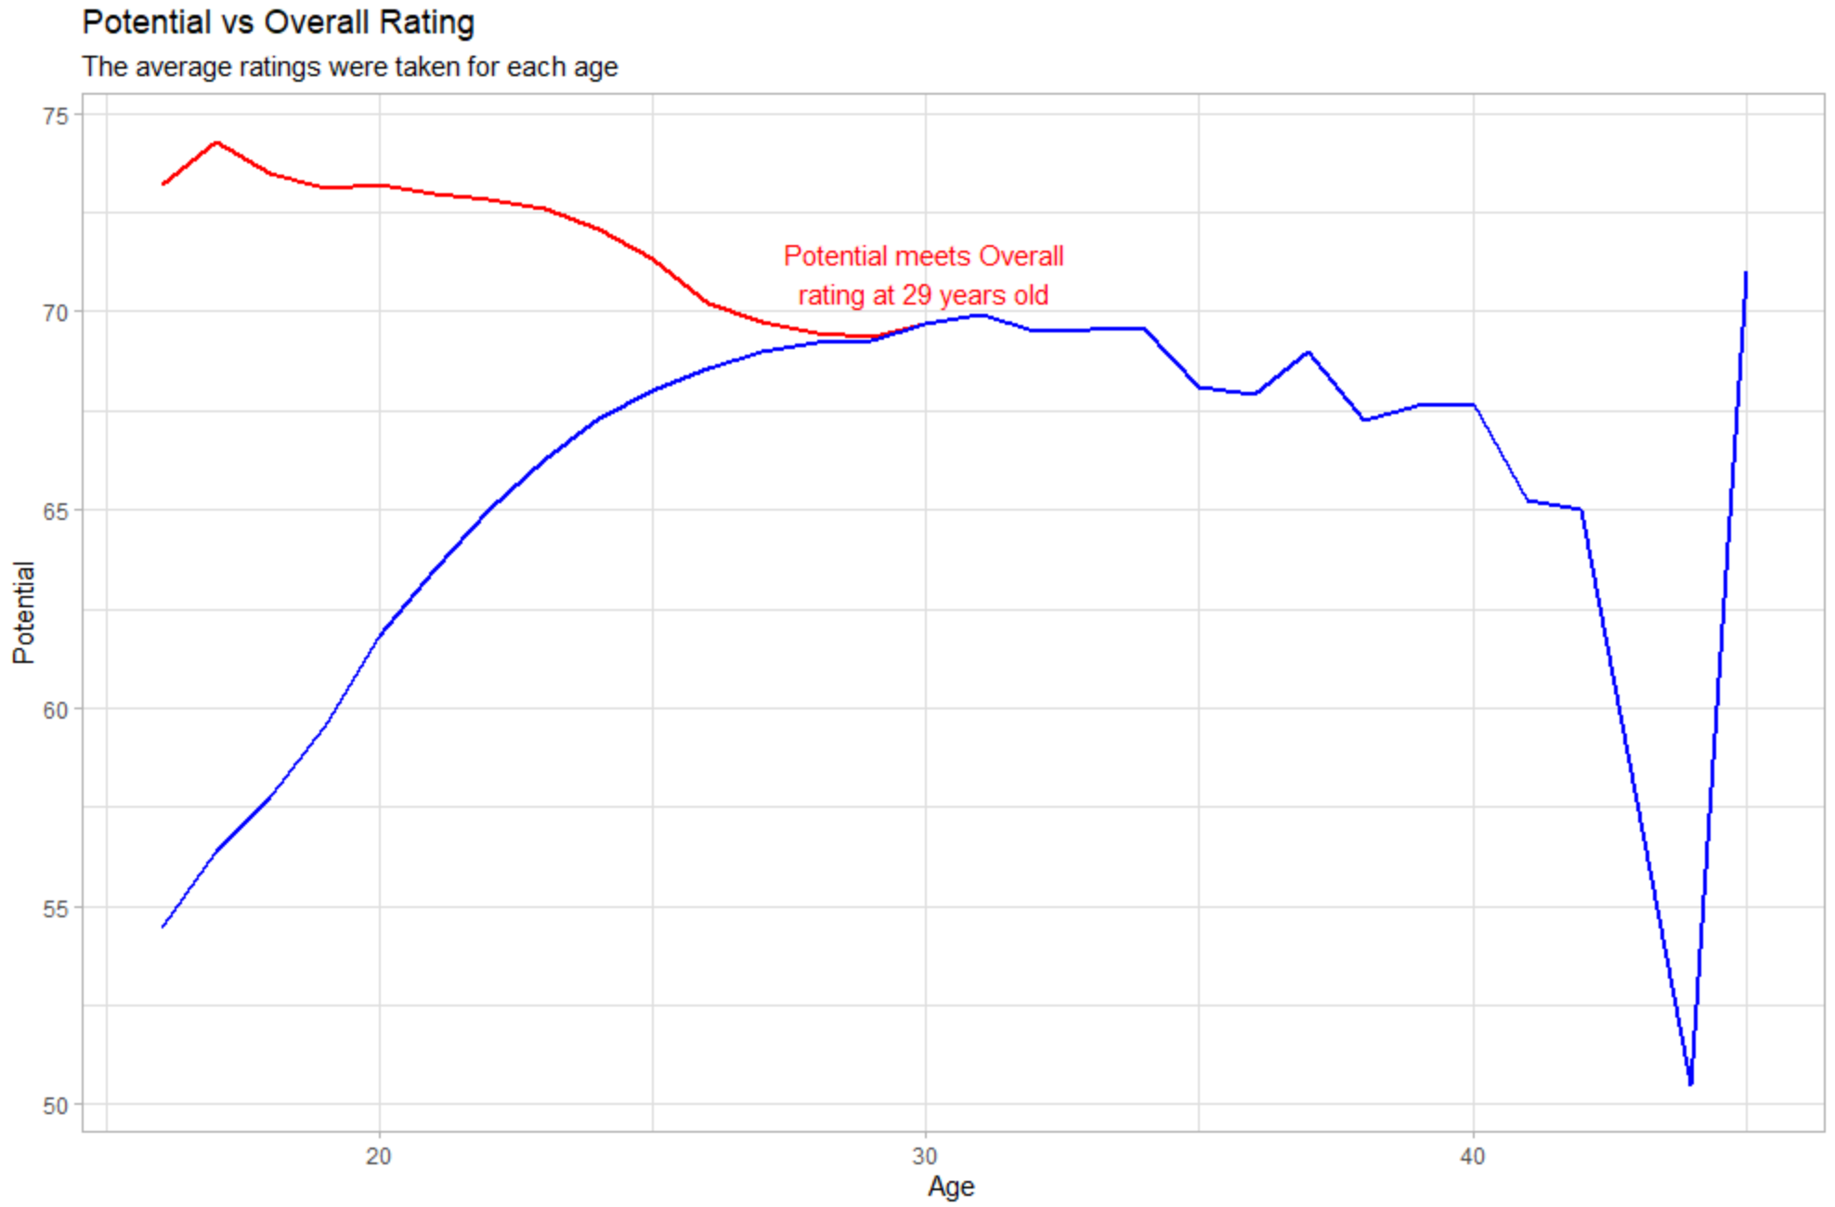
PLAYER POTENTIAL AND OVERALL RATING VS AGE

Slide 11
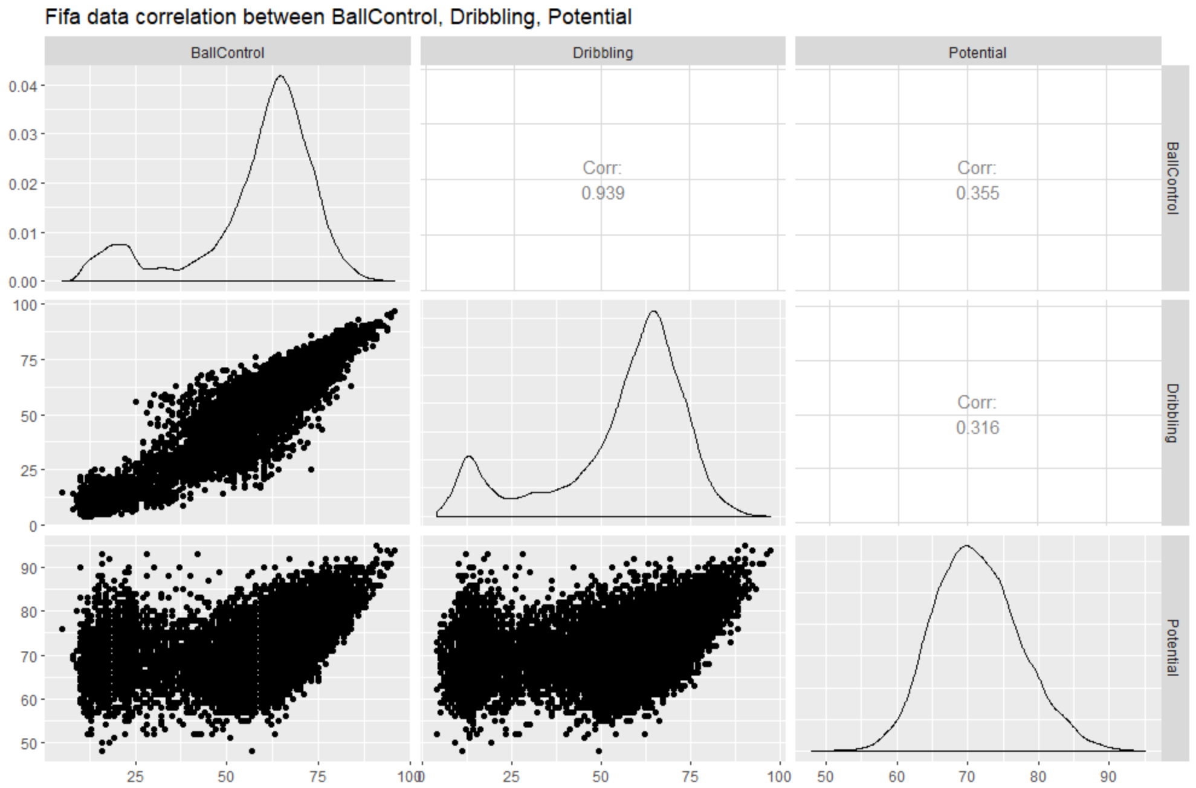
CORRELATION OF POTENTIAL VS BALL CONTROL AND DRIBBLING

Slide 12
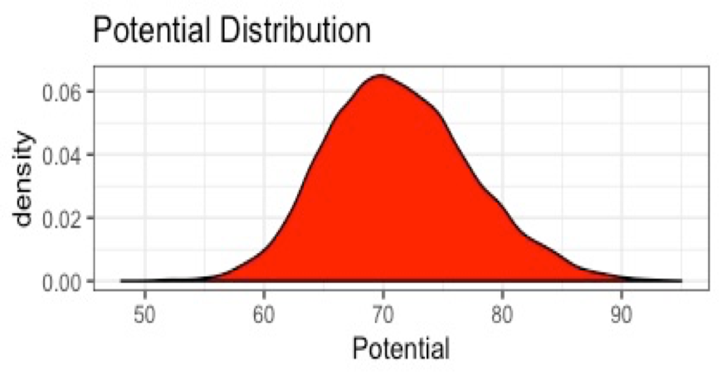
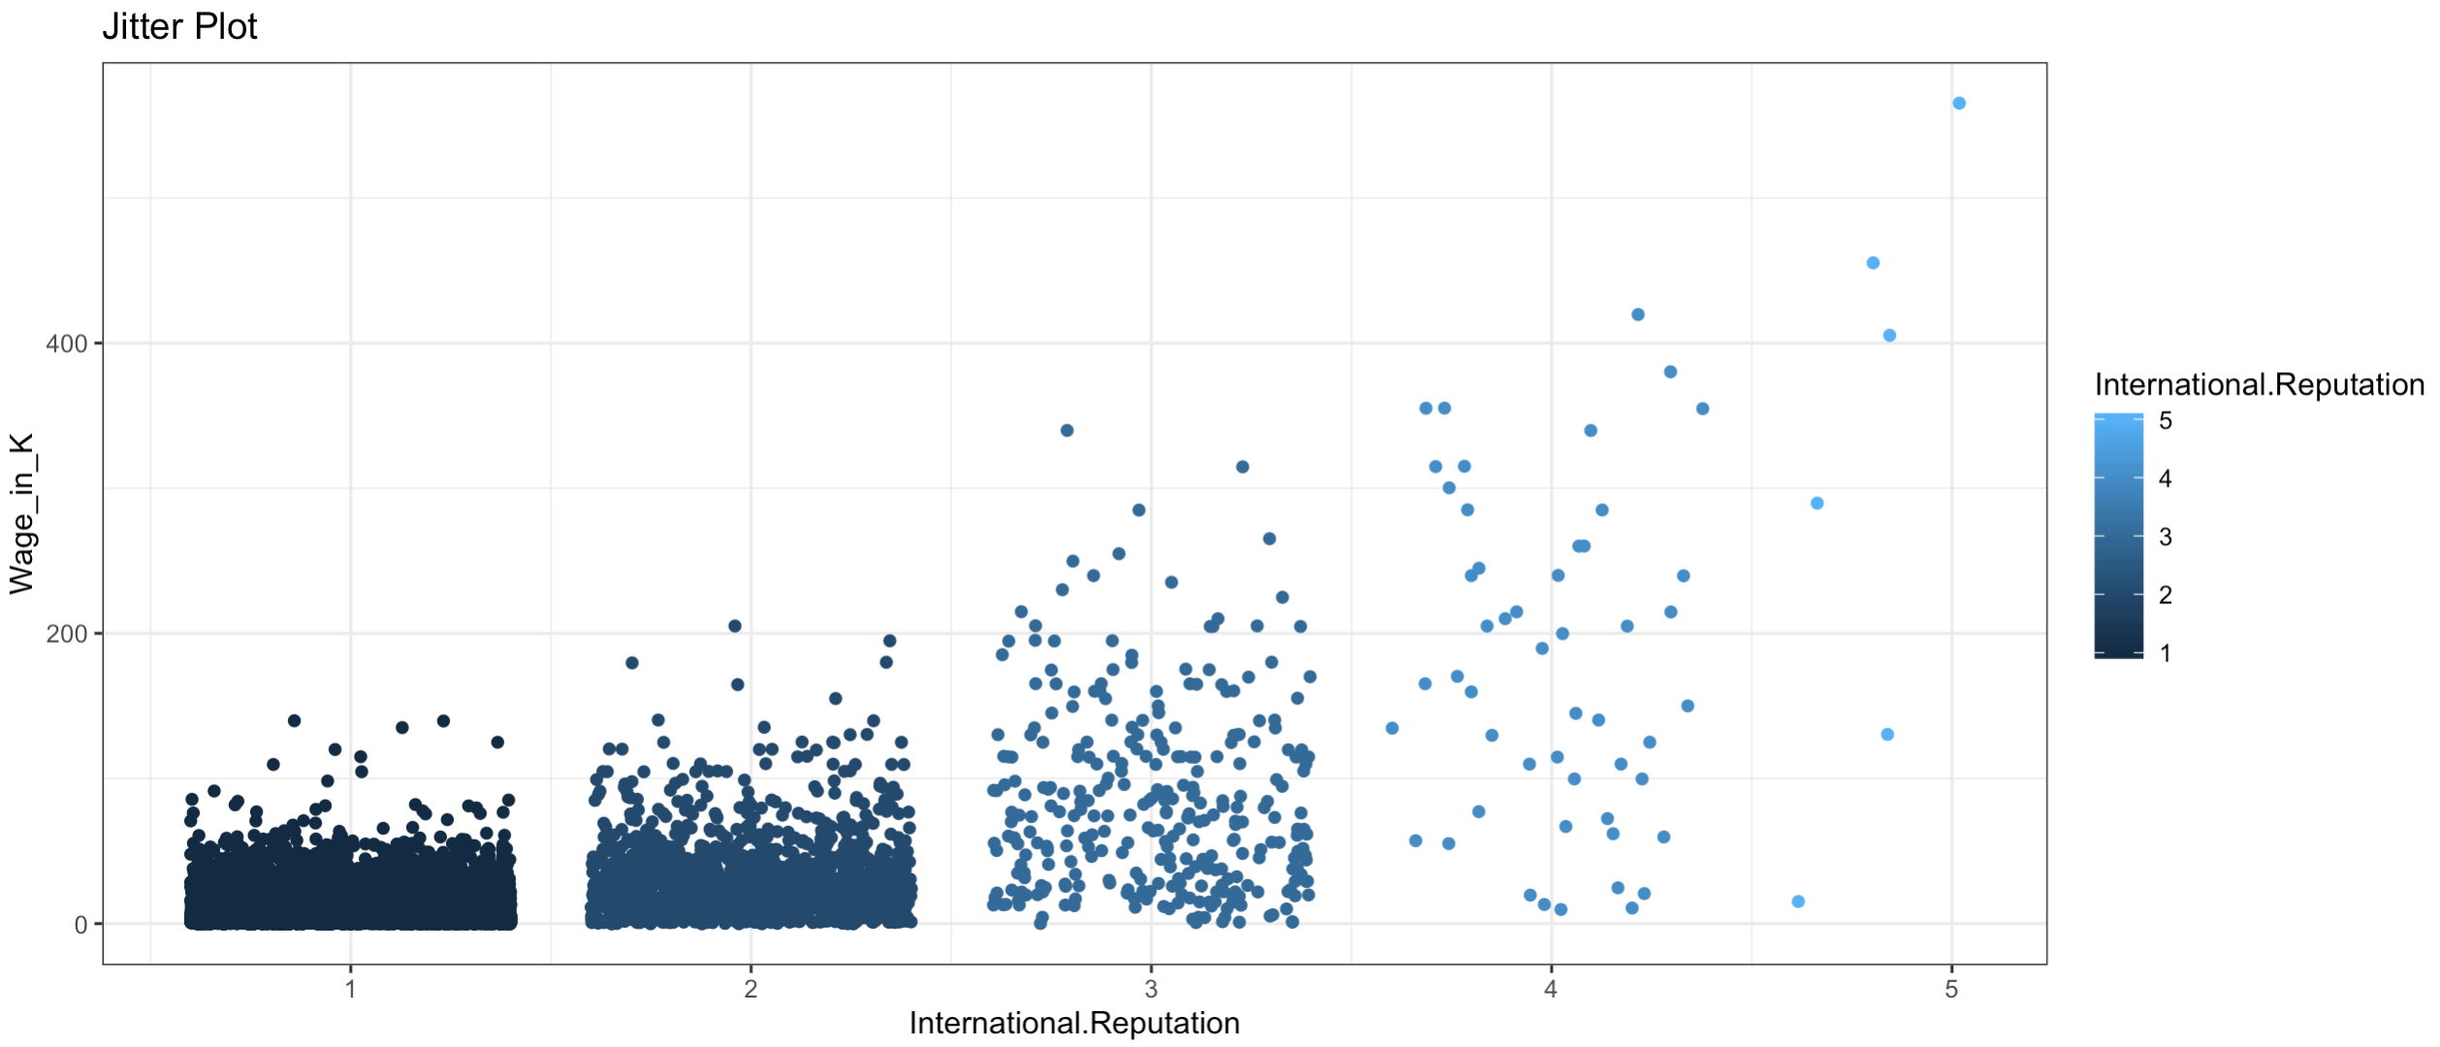
DENSITY PLOT
Result: Maximum players in the dataset have potential in between 65-75
JITTER PLOT

Slide 13
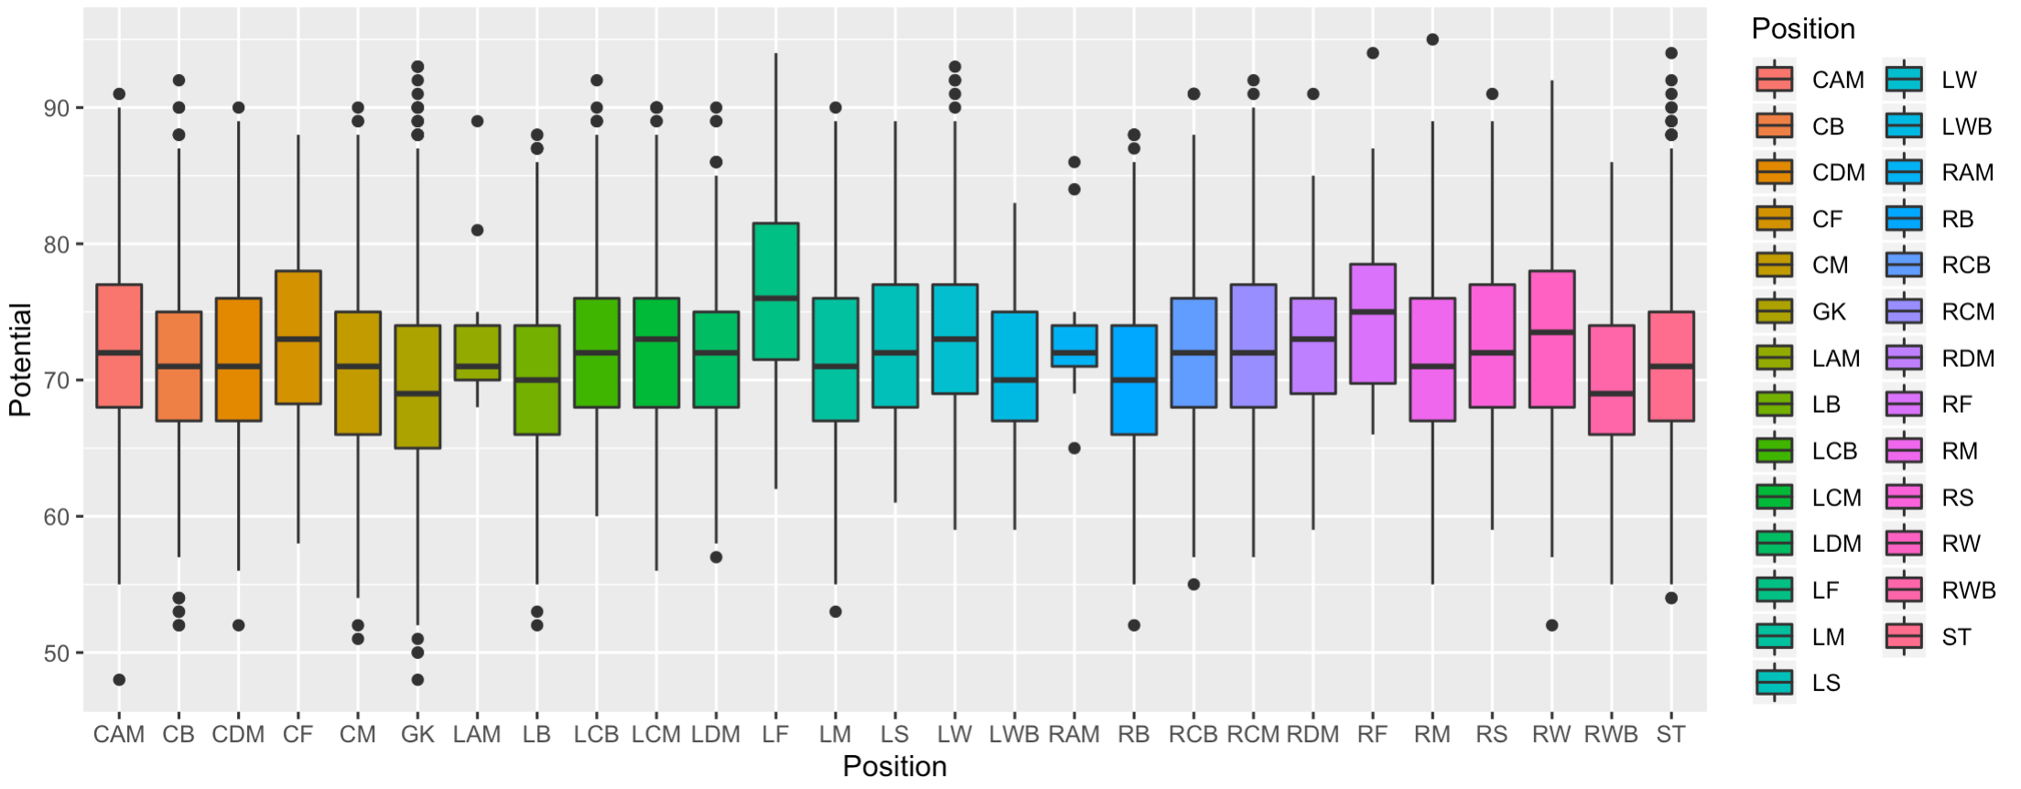
BOX PLOT
Highest Upper Quartile
Highest median
Highly preferred position
Outliers

Slide 14
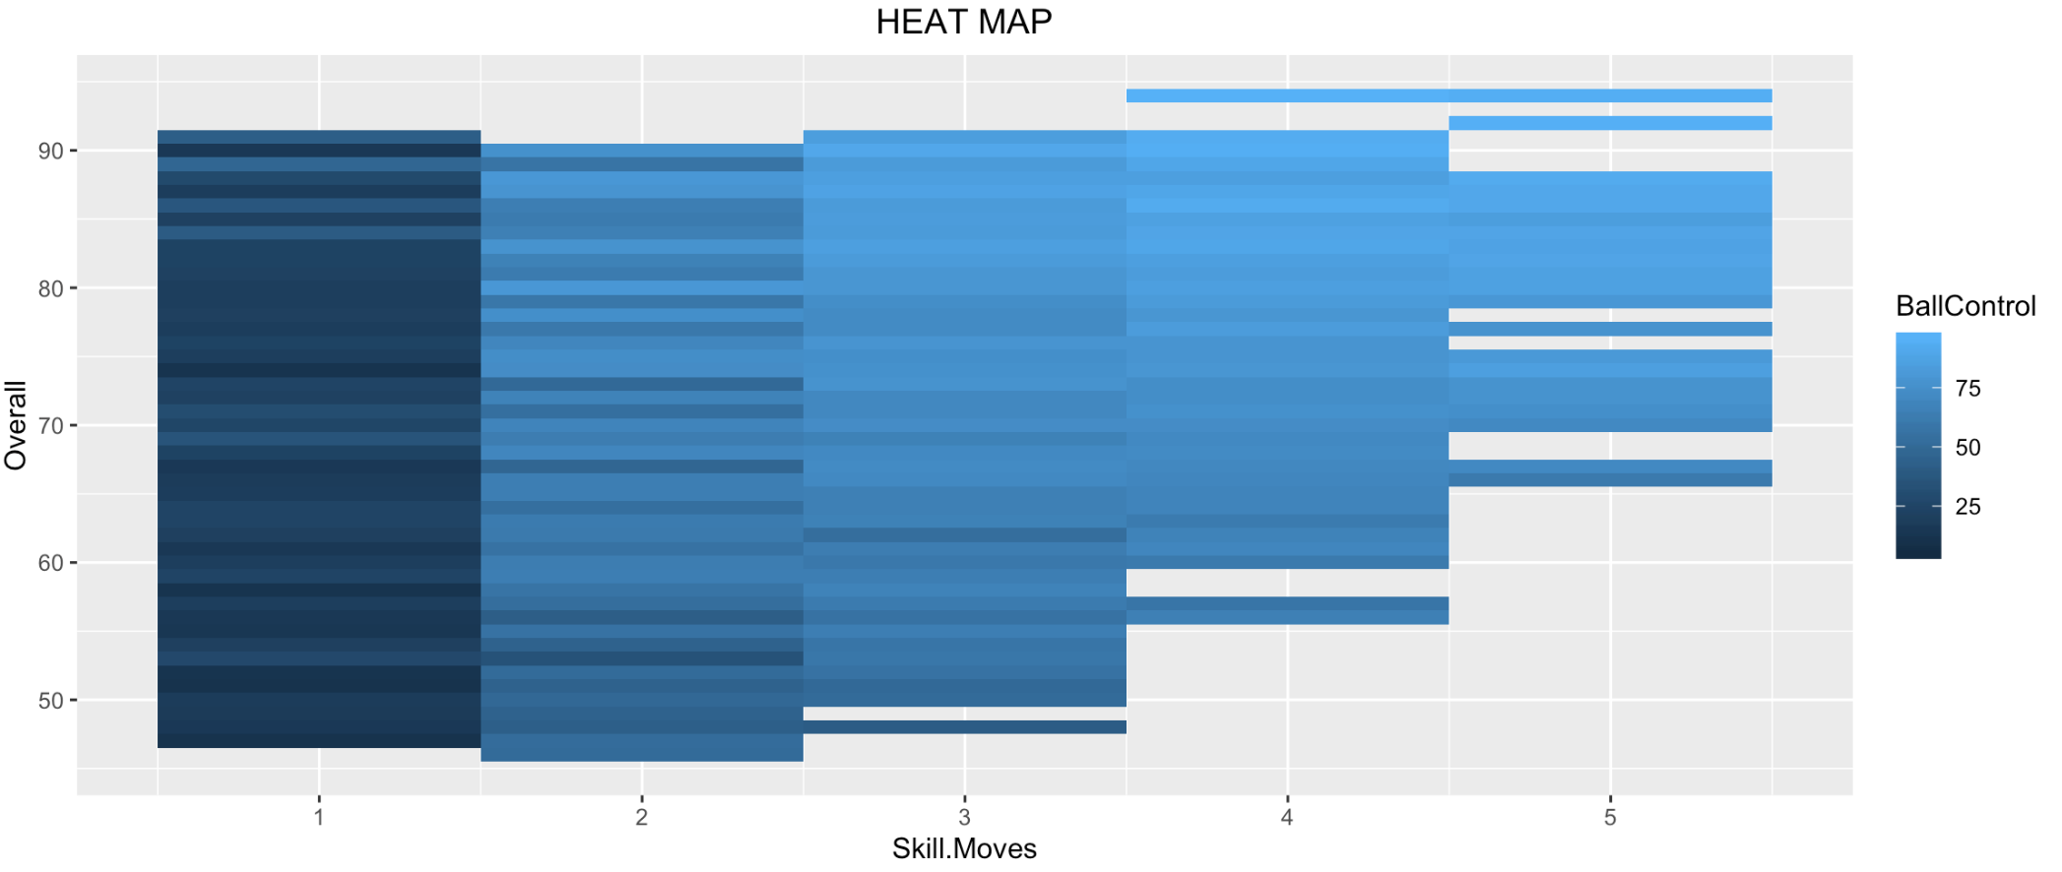
OVERALL RATING vs SKILLS vs BALL CONTROL

Slide 15
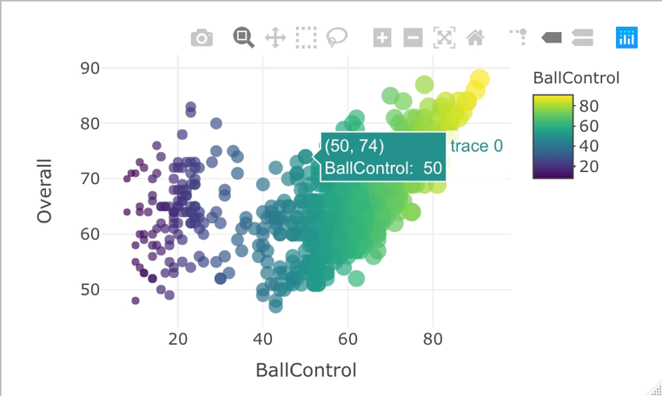
PLAYER OVERALL RATING vs BALL CONTROL USING PLOTLY

Slide 16
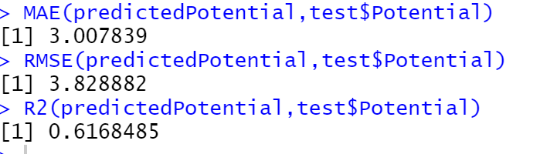
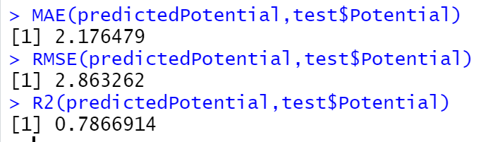
PREDICTING PLAYER POTENTIAL
For predicting player potential, we ran a correlation between the Potential variable and all other variables in the dataset and for running a linear regression and random forest models we chose top 6 variables with high correlation
  Age, Wage_in_K, ShortPassing, Dribbling, BallControl, Reactions
Linear regression Model:
Random Forest Model:

Slide 17

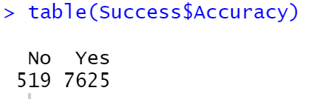
TESTING ACCURACY WITH LINEAR REGRESSION
Split the data:
No of rows in train: 9774
No of rows in test: 8144
Result:
We predicted player potential using Linear regression model and after setting an error range of 10% in predicted value, we had an Accuracy of 7625/(519+7625) = 93.62%

Slide 18
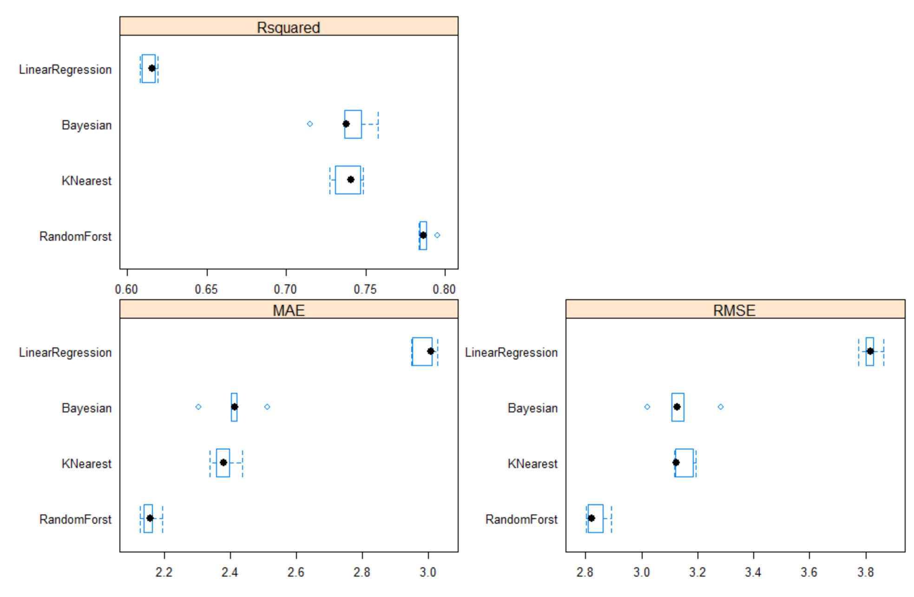
COMPARING MODEL PERFORMANCE

Slide 19
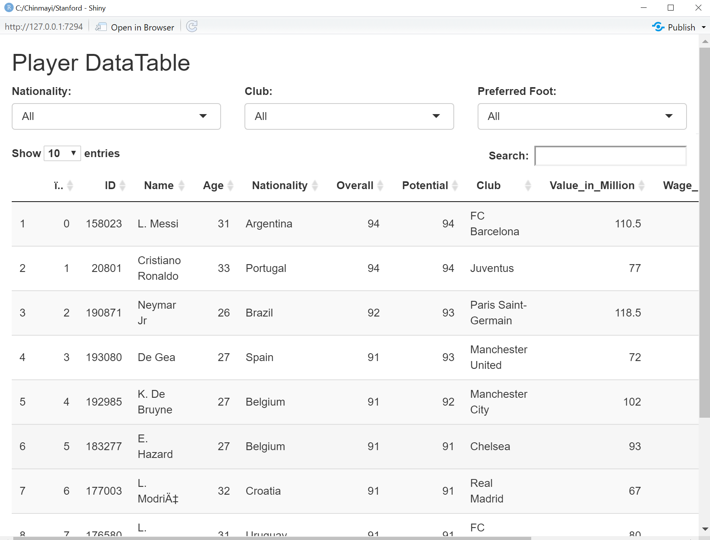
USING SHINY APP

Slide 20
CONCLUSION
Data shows that older players are currently playing at their full potential
Random forest model is better to predict the FIFA-19 Player potential compared to Linear Regression, Bayesian and K-Nearest

Slide 21

THANK YOU

